Slide 1
TRENDS IN THE PERIODIC TABLE
MR. LAWRANCE OKUYO
30th may 2024
Prep lesson

Slide 2
Elements in period 3 include
Element | Sodium | Magnesium | Aluminium | Silicon | Phosphorus | Sulphur | Chlorine | Argon
Symbol | Na | Mg | Al | Si | P | S | Cl | Ar
Atomic no. | 11 | 12 | 13 | 14 | 15 | 16 | 17 | 18

Slide 3
Bonding and structure in the elements
The structures of the elements vary across the period.
The first three are metallic, with giant metallic structures where their atoms are held by metallic bonds.
Silicon is a non metal with a giant covalent structure.
The silicon atoms are held by many strong covalent bonds.
The rest are also non metals with simple molecules, held by weak van der Waals forces

Slide 4
The metallic ELEMENTS
Sodium, magnesium and aluminum all have giant metallic structures.
In sodium, only one electron per atom is involved in the metallic bond
In magnesium, both of its outer electrons are involved,
In aluminum all three are involved.

Slide 5
THE GIANT COVALENT STRUCTURE OF SILICON
Silicon has a network covalent structure like that of diamond.
Each silicon atom is covalently bonded to four other silicon atoms

Slide 6
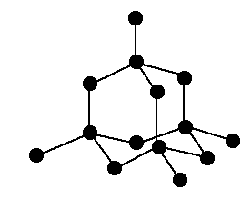
The giant covalent structure of silicon

Slide 7
The simple molecules
Phosphorus, sulfur, chlorine and argon are simple molecular substances with only van der Waals attractions between the molecules.
The strength of the van der Waals’ forces decreases as the size of the molecule decreases, so the melting points and boiling points decrease in the order S8> P4> Cl2>Ar

Slide 8
VARIATION OF MELTING POINTS AND BOILING POINTS ACROSS PERIOD 3
The chart shows how the melting and boiling points of the elements change as you go across the period.
The figures are plotted in kelvin rather than °C to avoid showing negative temperatures.

Slide 9
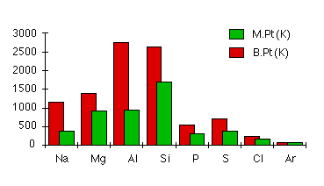
Trend in boiling point and melting point across period 3

Slide 10
Explaining the trend in boiling point across period 3
Melting and boiling points increase across the three metals because of the increasing strength of their metallic bonds.
The number of electrons which each atom can contribute to the delocalized "sea of electrons" increases.
The atoms also get smaller and have more protons as you go from sodium to magnesium to aluminum. The attractions and therefore the melting and boiling points increase

Slide 11
Why is the melting/boiling point of silicon very high?
Silicon has high melting and boiling points due to its giant covalent structure/giant molecular structure.
Melting or boiling silicon requires the breaking of strong covalent bonds.

Slide 12
cont’d
A lot of heat energy is required to break the strong covalent bonds.

Slide 13
Phosphorus, sulfur, chlorine and argon are simple molecular substances with only van der Waals attractions between the molecules.
Their melting or boiling points are lower than those of the first four members of the period which have complex structures.

Slide 14
The magnitudes of the melting and boiling points depend on the strength of the van der waals forces whose strength increases with increase in molecular mass.

Slide 15
phosphorus exists as tetratomic molecule P_{4,} Sulphur exists as s8 molecule, chlorine exists as a diatomic molecule cl2 whereas Argon is monoatomic, Ar.
Therefore their molecular masses increase in the order Ar>Cl2>P4>S8.
The strength of the van der waals forces increases in the same order and thus melting and boiling points increase in the same order.

Slide 16
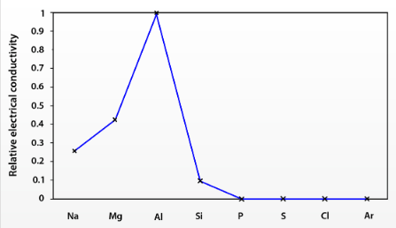
Trend in Electrical conductivity across period 3 elements

Slide 17
ELECTRICAL CONDUCTIVITIES OF PERIOD 3 ELEMENTS
Sodium, magnesium and aluminum are good conductors of electricity.
Conductivity increases from sodium to magnesium to aluminum.
The three metals conduct electricity because the delocalized electrons (as in the "sea of electrons" model) are free to move throughout the solid or the liquid metal.

Slide 18
Silicon is a semiconductor.
Phosphorus, sulfur, chlorine, and argon are nonconductive because they lack delocalized/ mobile electrons.

Slide 19
The three metals conduct electricity because the delocalized electrons (as in the "sea of electrons" model) are free to move throughout the solid or the liquid metal.
The other elements do not conduct electricity because they are simple molecular substances. without free, delocalized electrons.

Slide 20
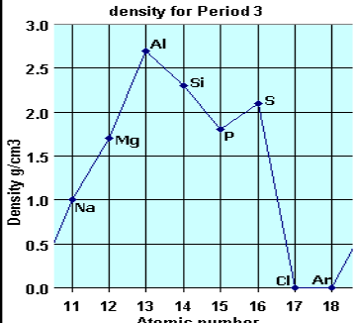
Variation in density across period 3 elements

Slide 21
The density increases from sodium to aluminium as the atomic radii decrease and the bonding gets stronger with 1 ==> 3 bonding electrons (delocalised outer valency electrons in the metal lattice). However, they are relatively low densities compared to most metals.

Slide 22
Silicon, phosphorus and sulfur have a low densities, typical of non–metallic covalent solids.
Chlorine and argon are small covalent molecules and have very low densities being gaseous at room temperature because only weak intermolecular forces act between them.

Slide 23
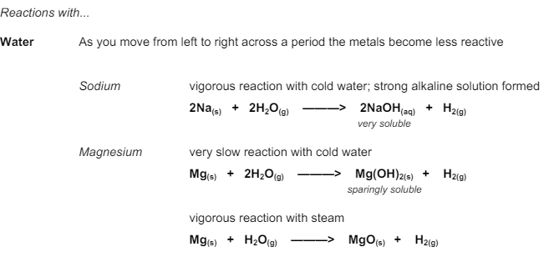
Chemical properties of period 3 elements

Slide 24
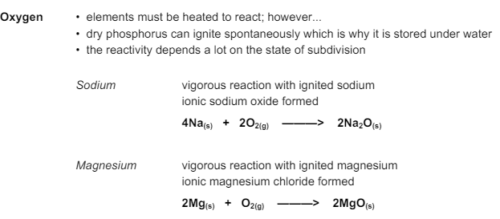

Slide 25
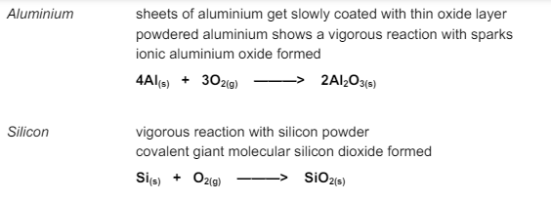

Slide 26
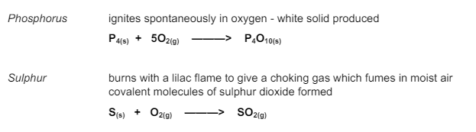

Slide 27
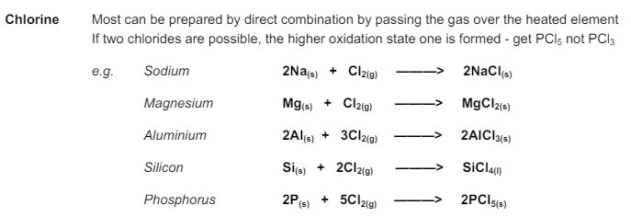

Slide 28

Any questions?

Slide 29
GOOD NIGHT TO YOU’ LL

Slide 30
Graphite conducts electricity because it has mobile electrons
Thank you

